Slide 1
Building a Datapath
CS3432 Fall 2021
Shirley Moore, Instructor
svmoore@utep.edu
October 19, 2021

Slide 2
Schedule for Today’s Class
Announcements (10 min)
Practice problems from last class (30 min)
A.1, A.6, full adder circuit - see answers in Files/ClassMaterials/Digital Logic Practice Problem Solutions
Building a datapath for arithmetic-logical instructions - registers + ALU (30 min)
Wrapup (5 min)
Pick up midterm exam (5 min)

Slide 3
Announcements
Expect to have grades so far on BlackBoard by end of this week
Midterm exam
Range 38.5 (19.25%) to 181.5 (90.75%), average 55%, median 54%
Question 2 thrown out
Optional retest on problems 17 and 18 next Tuesday in class (last 30 minutes)
Extra credit on midterm exam grade: Choose up to 4 multiple choice/answer questions that you got wrong and write up or make a video explaining the question and how to get the correct answer. 10 pts/question.
Lab 3 milestone 1 due Oct 24, milestone 2 due Oct 31
Has everyone been able to install Logisim? If not, get help in lab today!
Lab 3 & 4 Prep assignment due tomorrow 11:59pm on Teams
Notes:
Final:
2 parts
Part 1: First half of the class (essentially the midterm)
Midterm extra credit place to turn in will be on Teams.

Slide 4
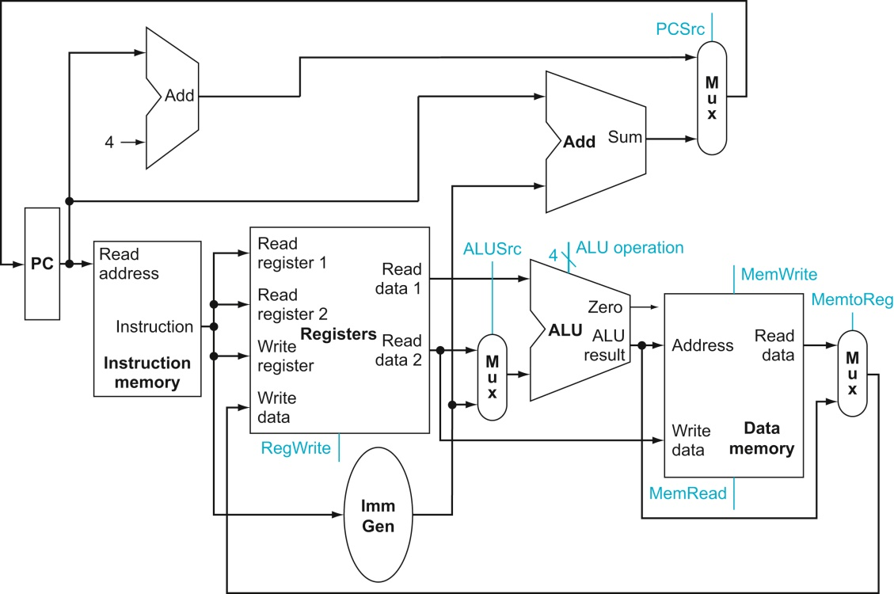
Building our first Datapath
P&H 4.3
Datapath element
A unit used to operate on or hold data within a processor
Register file, ALU, adders, instruction and data memories
Let’s start with the elements required to execute the arithmetic-logical instructions
Need register file + ALU

Slide 5
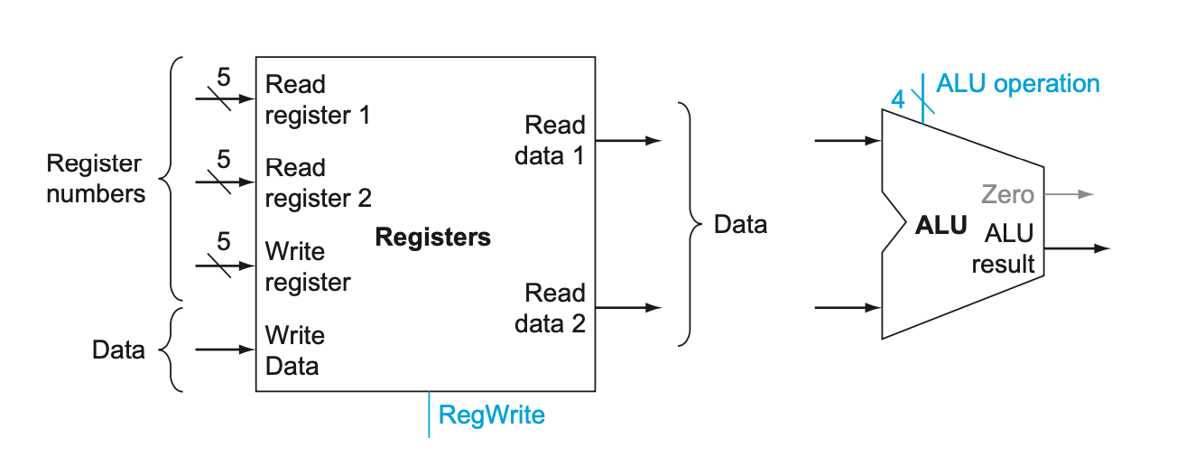
R format instructions
For our RISC-V subset, this includes add, sub, and, or, and xor
They all read two registers, perform an ALU operation on the contents of the registers, and write the result to a register.
Example: add x7, x5, x6
Need to read two data words from the register file and write one data word into the register file for each instruction
For each data word to be read, we need an input to the register file that specifies the register to be read and an output from the register file that will carry to value that has been read.
To write a data word, we need two inputs -- the register to be written and the data to write.
Writes are controlled by the write control signal (RegWrite) which must be asserted for a write to occur on the clock edge.
Notes:
A and B input are 32 bits and must do add, or, xor,
Branch instructions will not use the ALU
We will use a comparator

Slide 6
ALU control inputs
The RISC-V ALU in P&H Appendix A defines the following combinations of the four control inputs:
Why does 0110 indicate subtract?
For Lab 3, we will add XOR with ALU_Ctrl = 0010 and we will change add to ALU_Ctrl = 0011 and subtract to ALU_Ctrl = 0111.
ALU control lines | Operation
0000 | AND
0001 | OR
0010 | add
0110 | subtract
Notes:
C_in has to be one

Slide 7
ALU control inputs for Lab 3
ALU control lines | Operation
0000 | AND
0001 | OR
0010 | XOR
0011 | add
0111 | subtract

Slide 8
To Build Your 32-bit ALU
Tasks:
Build a 1-bit full adder
Use logic gates and your 1-bit full adder to construct a 1-bit ALU that performs and, or, xor, add, and subtract
For subtraction, use the adder and negate input B using ALU_Ctrl₂
Use a multiplexer with ALU_Ctrl₀ and ALU_Ctrl₁ as selection bits to select the output for the ALU
Chain together 32 1-bit ALUs to construct a 32-bit ALU
Logisim demo of 4-bit ALU
Construct 32-bit ALU as part of Milestone 1 for Lab 3

Slide 9
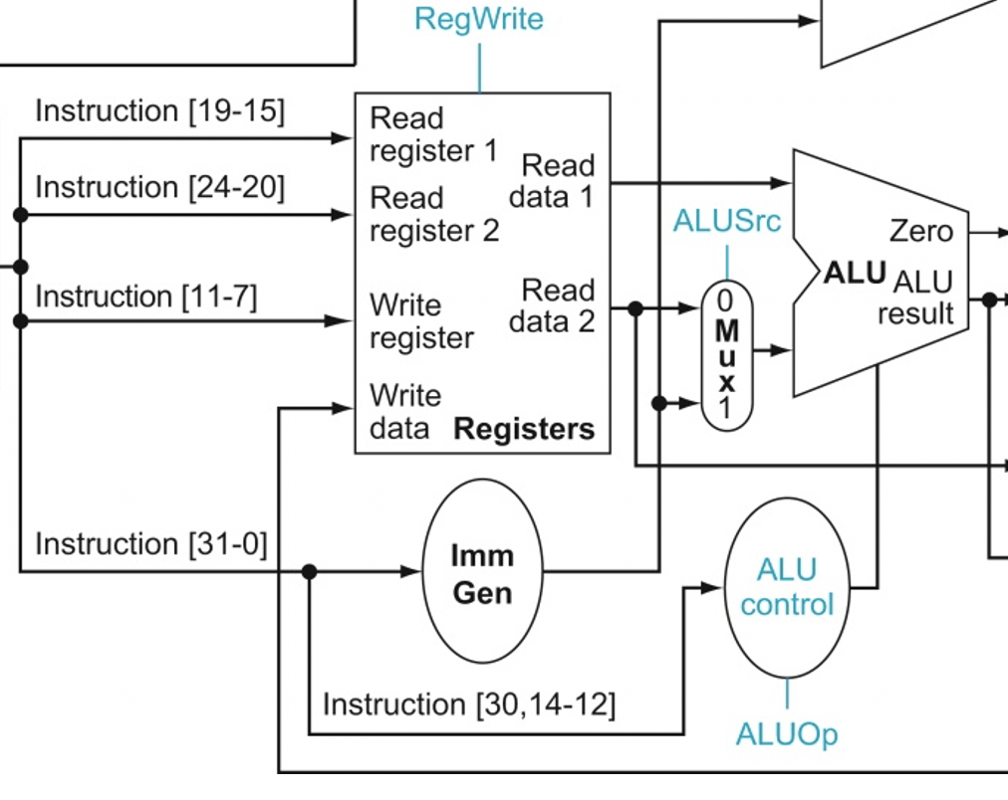
Now let’s add immediate versions of arithmetic-logical instructions
Instead of rs2, the second input to the ALU comes from the immediate field
We need to sign-extend the 12-bit immediate value to 32 bits
We need a 2-to-1 MUX to choose the ALUSrc for the second second ALU input
, 6-4]

Slide 10
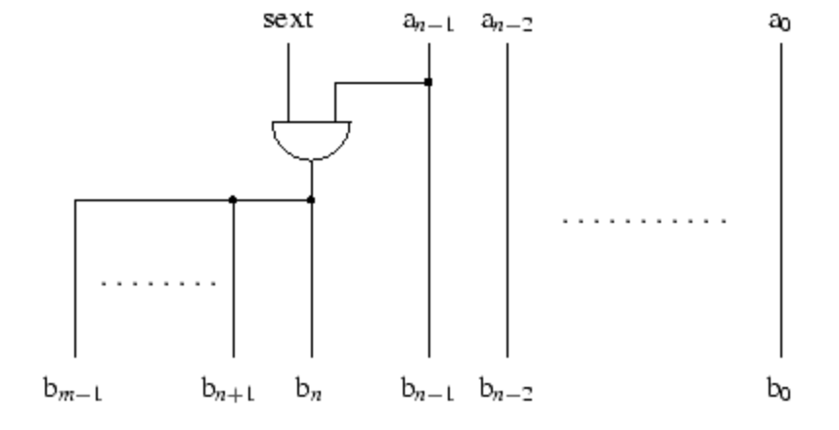
Sign extension circuit
Can use Wiring/Bit Extender in Logisim
Bit Width In | 12
Bit Width Out | 32
Extension Type | Sign
Sign extension will suffice for Lab 3.
For Lab 4, we will construct a full RISC-V immediate generation circuit.

Slide 11
Need control logic to determine the which parts of the datapath are used for an instruction.
Instead of rs2, the second input to the ALU comes from the immediate field
We need to sign-extend the 12-bit immediate value to 32 bits
We need a 2-to-1 MUX to choose the ALUSrc for the second second ALU input
, 6-4]

Slide 12
Instructions with ALU_Ctrl and ALU_Src outputs
Instruction | Format | Opcode | Funct3 | Funct7 | ALU_Ctrl | ALU_Src
AND | R | 0110011 | 111 | 0000000 | 0000 | 0
OR | R | 0110011 | 110 | 0000000 | 0001 | 0
XOR | R | 0110011 | 100 | 0000000 | 0010 | 0
ADD | R | 0110011 | 000 | 0000000 | 0011 | 0
SUB | R | 0110011 | 000 | 0100000 | 0111 | 0
ANDI | I | 0010011 | 111 |  | 0000 | 1
ORI | I | 0010011 | 110 |  | 0001 | 1
XORI | I | 0010011 | 100 |  | 0010 | 1
ADDI | I | 0010011 | 000 |  | 0011 | 1
LW | I | 0000011 | 010 |  | 0011 | 1
SW | S | 0100011 | 010 |  | 0011 | 1
We will handle branch instructions with a separate comparator, not using the general ALU.
Which bits of an instruction do we need as inputs to our ALU_Control circuit?

Slide 13
Truth Table for ALU_Control Circuit
 | Inputs |  |  |  |  |  |  | Outputs
Inst’n | I₃₀ | I₁₄ | I₁₃ | I₁₂ | I₆ | I₅ | I₄ | ALU_Ctrl₃ | ALU_Ctrl₂ | ALU_Ctrl₁ | ALU_Ctrl₀ | ALU_Src
AND | 0 | 1 | 1 | 1 | 0 | 1 | 1 | 0 | 0 | 0 | 0 | 0
OR
XOR
ADD
SUB
ANDI | X | 1 | 1 | 1 | 0 | 0 | 1 | 0 | 0 | 0 | 0 | 1
ORI
XORI
ADDI
LW
SW
Finish as part of Milestone 1 for Lab 3
Use finished truth table to generate ALU_Control circuit in Logisim

Slide 14
To Build Your Register File
Use the Register component provided in the Logisim Memory library
Configure read and write ports and control lines as shown last class
Hardwire register x0 to have value 0
Logisim demo of register file with four 32-bit registers
Construct a register file with 32 32-bit registers as part of Milestone 2 for Lab 3

Slide 15
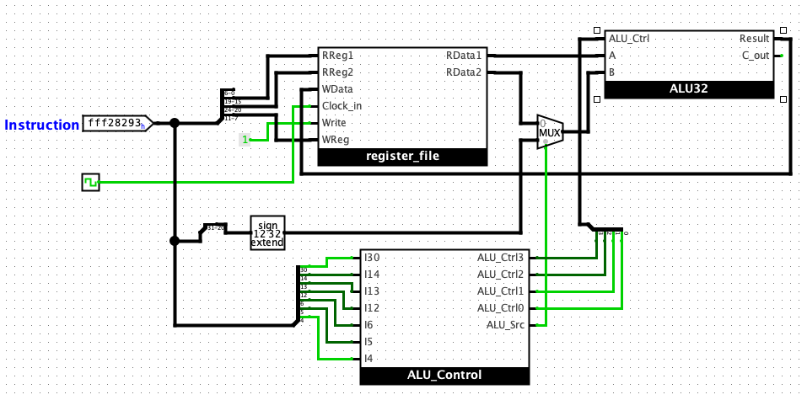
Datapath and Control for Arithmetic-Logical Instructions
Connect your ALU, register file, and ALU_Control circuits, using additional logic as needed, to construct a datapath that will take an arithmetic-logical instruction as input and execute the instruction.

Slide 16
Wrapup
Read P&H 4.3 (for today!)
Read P&H 5.1-5.2 and A.9 for Thursday

